Slide 1

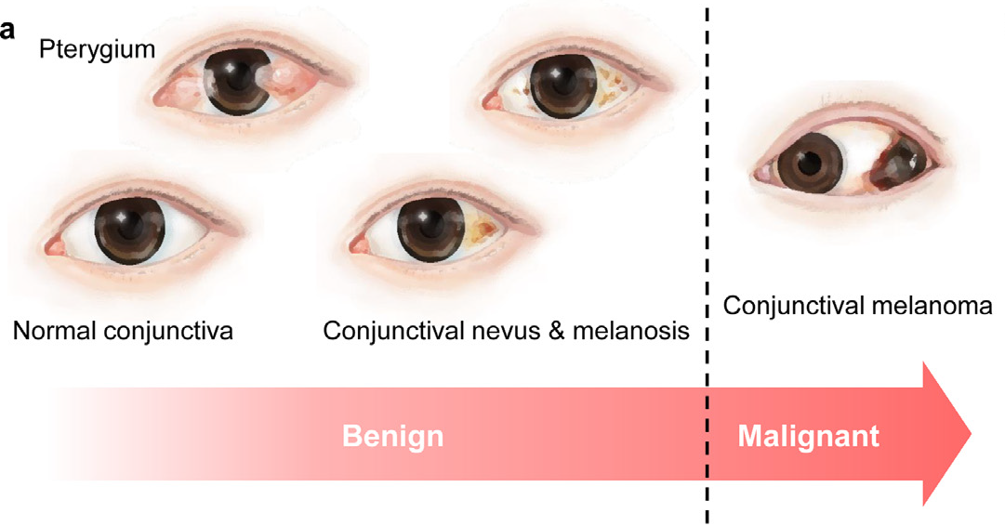
Deep Learning Based Conjunctival Melanoma Detection using Ocular Surface Images
Group Members:
S. Anusri (20MCME31)
M. Bhagya Sree (20MCME01)
Ankith Mall (20MCME19)
G. Srinivas (20MCME06)

Slide 2
Contents
Dataset and Data Augmentation techniques
GAN for Data Augmentation
Image Classification with CNN Models
MobileNetV2 Model
EfficientNetB7 Model
Conclusion

Slide 3
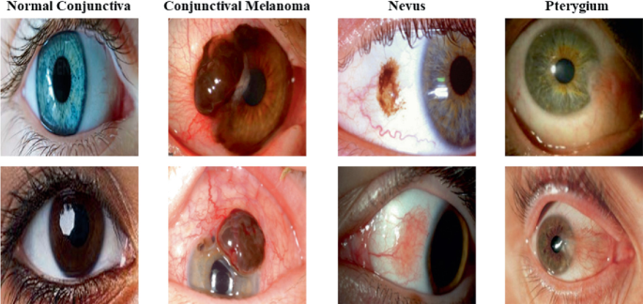
Dataset and Image Augmentation Techniques
The dataset consists of ocular surface images (pictures captured via smartphone)
Four main categories of images in dataset: Normal Conjunctiva (96 images), Pterygium (75 images), Nevus (86 images) and Conjunctival Melanoma (139 images)
Due to the small size of dataset, 4 different data augmentation techniques were applied to increase the number of images in the different classes:
Random rotation (+20 to -20 degree range)
Random affine transformation (degree = 0, translate range = (0.05, 0.15), scaling range = (0.9, 0.95))
Padding (range = (0, 10), fill = (black, white), mode = (constant, edge))
Color correction (brightness = (0, 0.2), contrast = (0, 0.2))

Slide 4
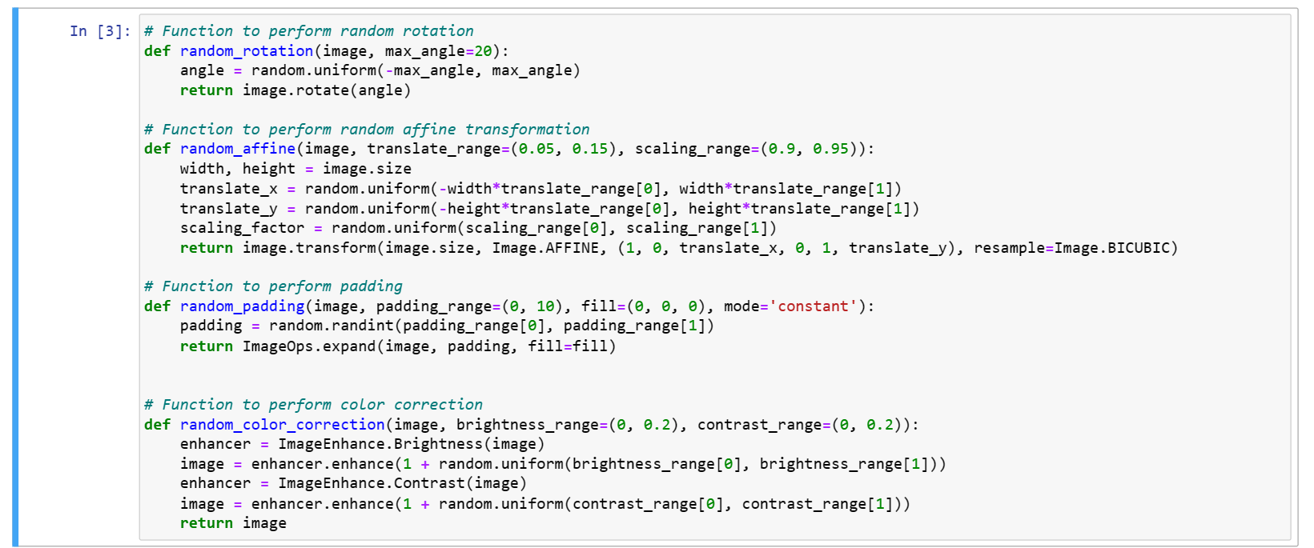
Data Augmentation functions

Slide 5
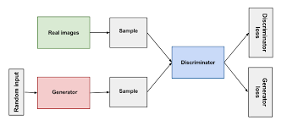
GAN for Data Augmentation
Considering dataset with 2-classes “normal” and “abnormal” containing 4000 images each, a PyTorch-based GAN Model is considered.
Generator and Discriminator Networks: The generator (G) generates synthetic images and the discriminator (D) discriminates between real and fake images.
Real images are passed through the discriminator, and the discriminator is trained to correctly classify them as real.
Fake images generated by the generator are passed through the discriminator, and the discriminator is trained to correctly classify them as fake.
The generator is trained to generate images that fool the discriminator into classifying them as real.
Generator (G) takes random noise as input and generates synthetic images. It consists of a sequence of transposed convolutional layers followed by batch normalization and ReLU activation functions. The generator's forward pass generates an image tensor as output.
Discriminator (D) consists of a sequence of convolutional layers followed by batch normalization, leaky ReLU activation functions, and a sigmoid activation function at the output.

Slide 6
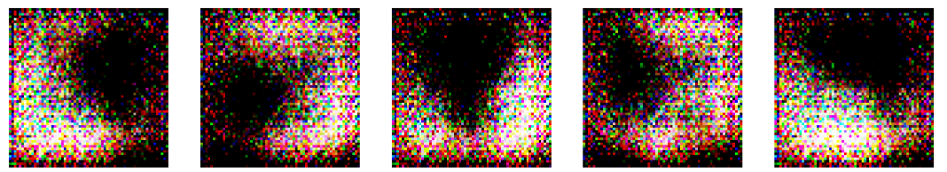
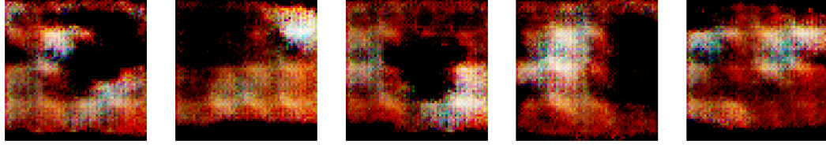
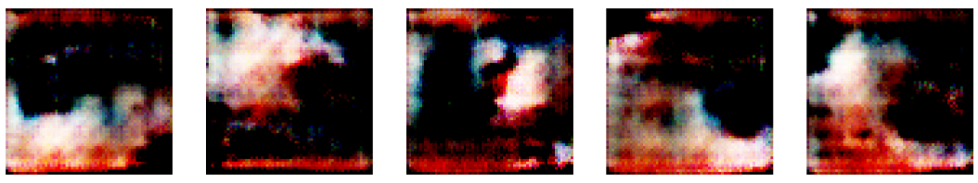
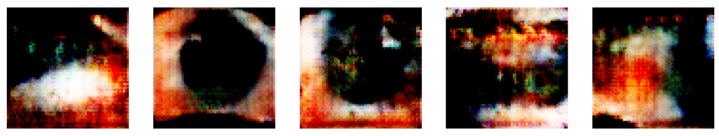
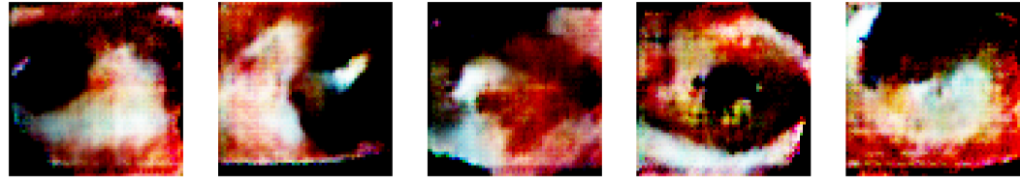
GAN for Data Augmentation - 100 epochs
Epoch 0
Epoch 10
Output considering Abnormal class of images
Epoch 20
Epoch 30
Epoch 40

Slide 7
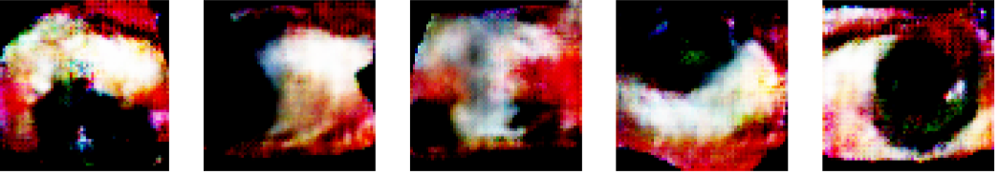
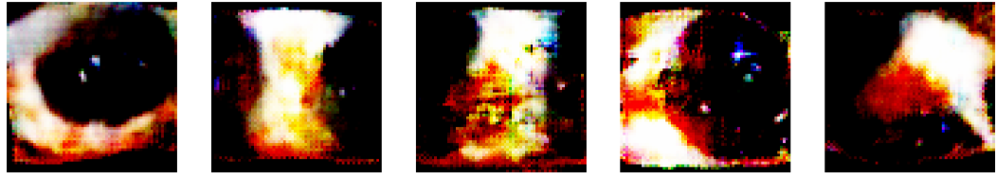
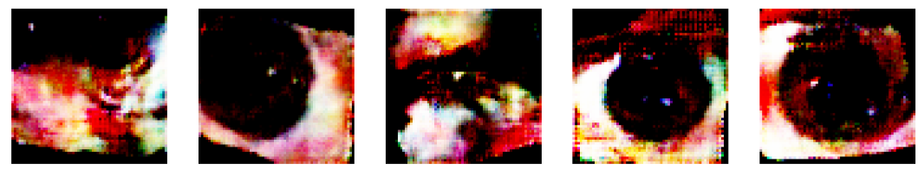
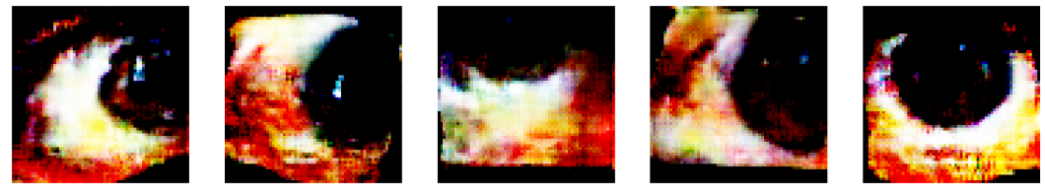
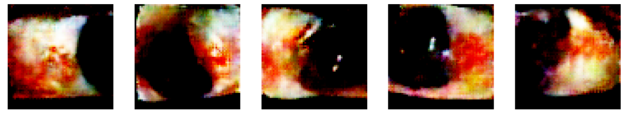
GAN for Data Augmentation - 100 epochs
Epoch 50
Epoch 60
Epoch 70
Epoch 80
Epoch 90

Slide 8
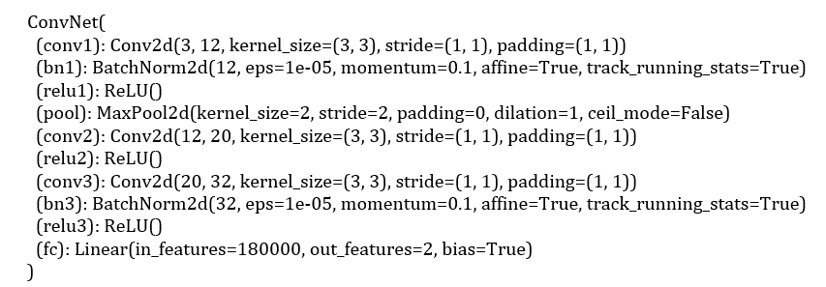
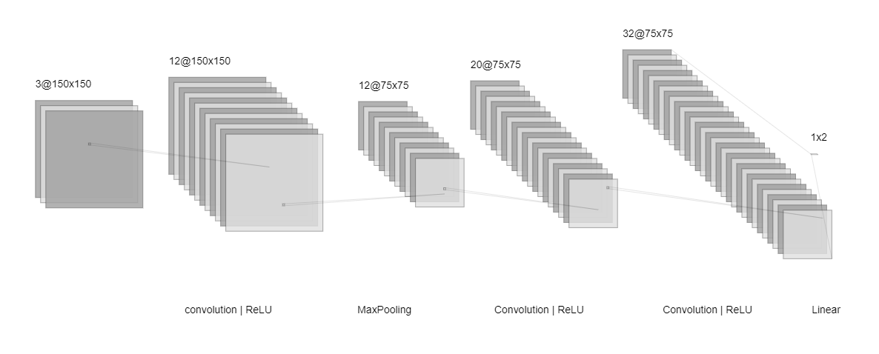
Image Classification with PyTorch-based CNN Models
2-class classification of "normal" and "abnormal" with 4000 images in each class.
Architecture of the Model:
Input Layer: The input images are RGB images resized to 150x150 pixels.
Evaluation Metrics (measuring the performance of the trained model)
Accuracy: 0.8671875
Precision: 0.9374534623976173
Recall: 0.786875
F1 Score: 0.8555895344886171
Confusion Matrix:
[[1516 84]
[ 341 1259]]
The model was trained for 5 epochs.

Slide 9
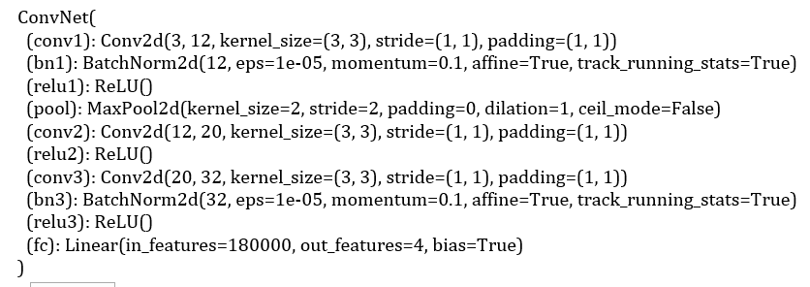
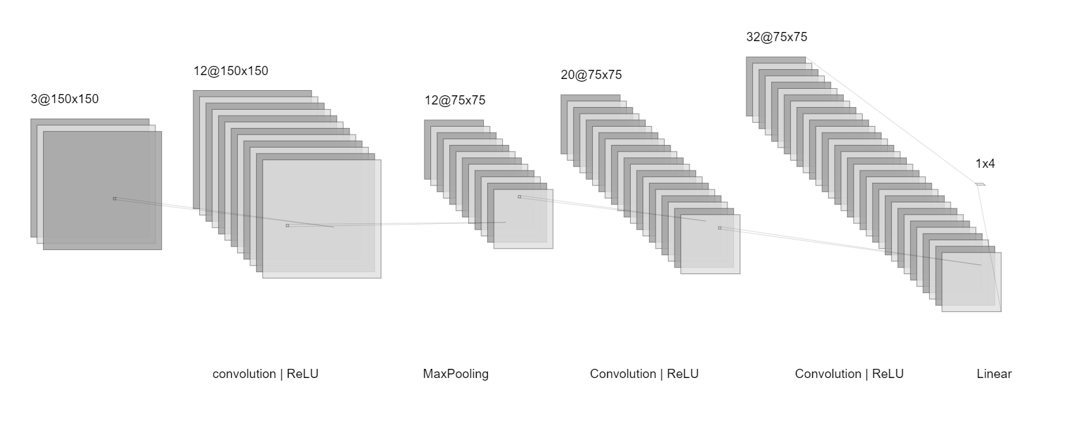
Image Classification with PyTorch-based CNN Models
4-class classification of "normal", “nevus”, “melanoma” and “pterygium” with 4000 images in each class.
Architecture of the Model:
Input Layer: The input images are RGB images resized to 150x150 pixels.
Evaluation Metrics (measuring the performance of the trained model)
Accuracy: 0.7630208333333334
Precision: 0.7923358575858589
Recall: 0.7630208333333334
F1 Score: 0.7596258703540104
Confusion Matrix:
[[793 15 52 100]
[ 52 525 178 205]
[ 37 27 718 178]
[ 25 7 34 894]]
The model was trained for 5 epochs.

Slide 10
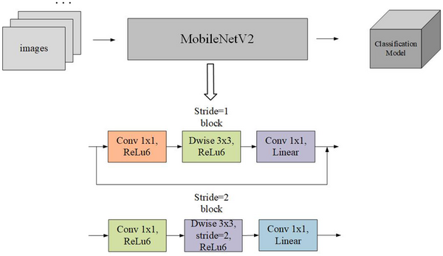
Transfer Learning - MobileNetv2 Model
2-class Image classification of “normal” and “abnormal” using TensorFlow and Keras considering 10,000 images in each class
The model architecture consists of a pre-trained MobileNetV2 (on ImageNet) base model for feature extraction, followed by additional layers for fine-tuning and adapting to the specific image classification task.
Preprocessing layers resize and rescale input image and the Dense and Dropout layers add capacity and regularization to the model.
The output layer produces class probabilities using softmax activation, and the model is trained using Adam optimizer and categorical cross-entropy loss.
Results obtained after training for 10 epochs:
Train Loss: 0.0084
Train Accuracy: 0.9980
Validation Loss: 0.0143
Validation Accuracy: 0.9959
Test Loss: 0.01935
Test Accuracy: 99.26%
The model was trained for 10 epochs.

Slide 11
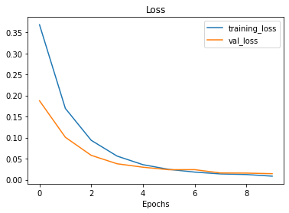
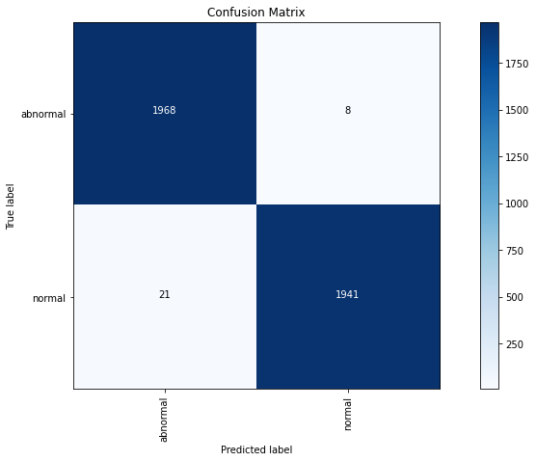
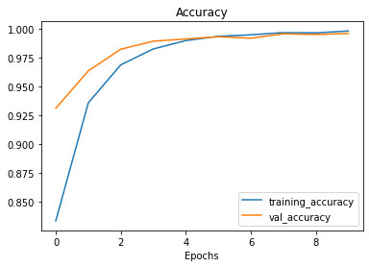
MobileNetv2 Model - 2 Class Classification

Slide 12
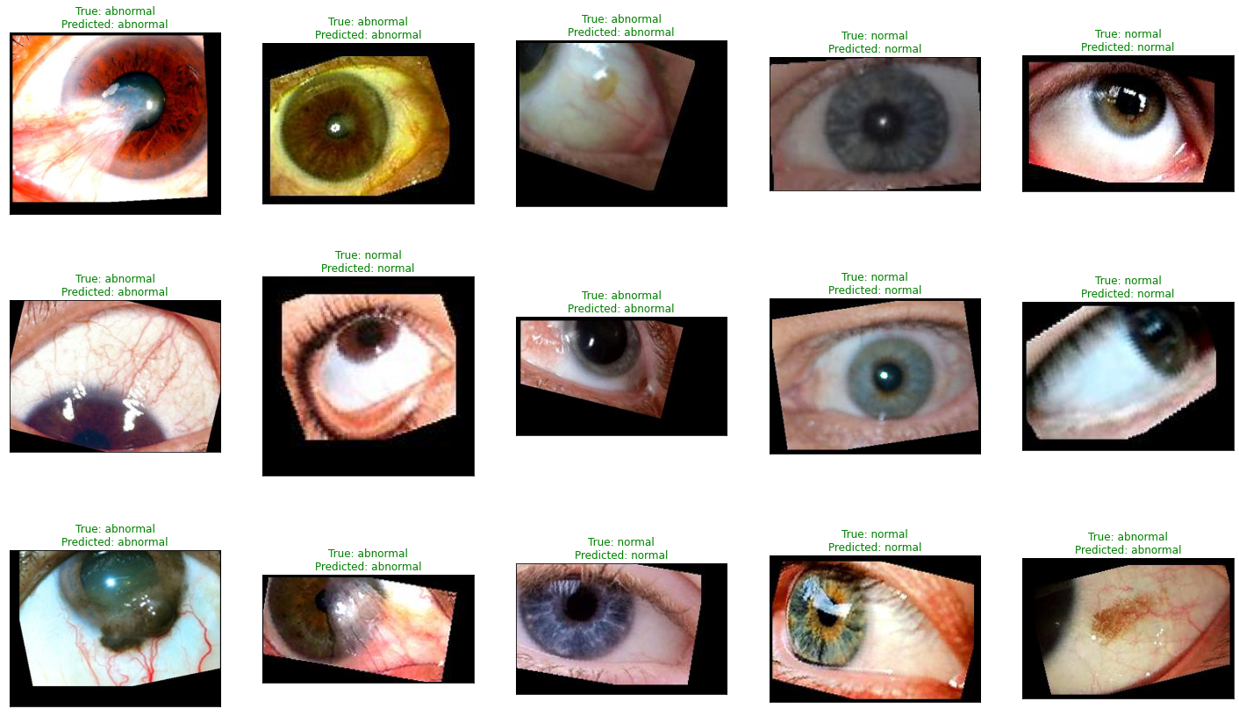
MobileNetv2 Model - 2 Class Classification

Slide 13
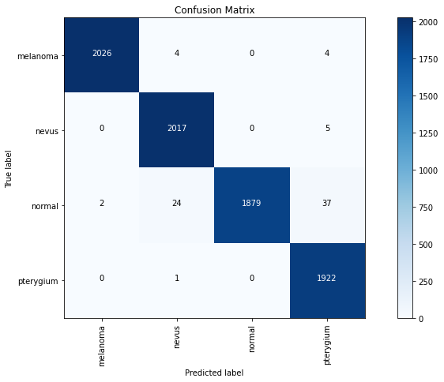
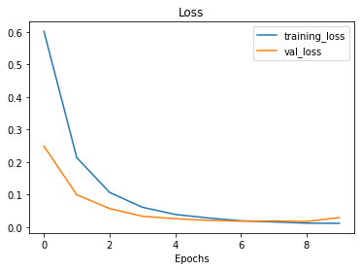
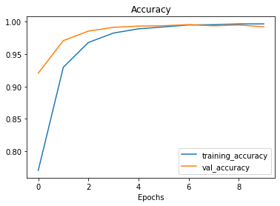
MobileNetv2 Model - 4 Class Classification
4-class Image classification of “normal”, “nevus”, “melanoma” and “pterygium” using TensorFlow and Keras considering 10,000 images in each class
Results obtained after training for 10 epochs:
Train Loss: 0.0116
Train Accuracy: 0.9966
Validation Loss: 0.0290
Validation Accuracy: 0.9921
Test Loss: 0.02832
Test Accuracy: 99.03%
The model was trained for 10 epochs.

Slide 14
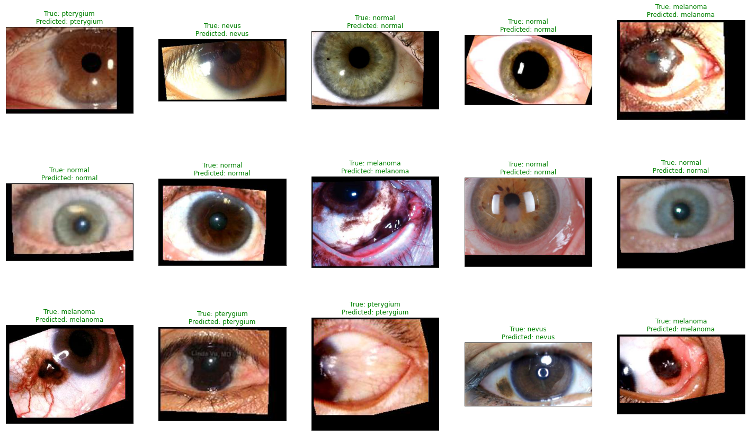
MobileNetv2 Model - 4 Class Classification

Slide 15
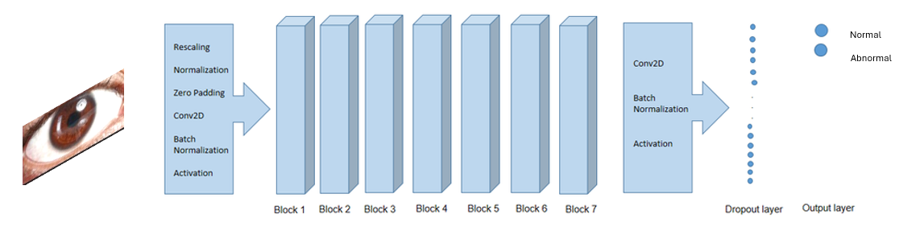
Transfer Learning - EfficientNetB7 Model
2-class Image classification of “normal” and “abnormal” using Tensorflow considering 10,000 images in each class
The pre-trained EfficientNetB7 model is used as the base model for feature extraction. It is loaded with pre-trained ImageNet weights.
The top classification layer, (Dense layer with softmax activation) responsible for predicting class probabilities, is removed from the pre-trained EfficientNetB7 model.
A Dense layer with 256 units and ReLU activation is added for feature processing and a Dropout layer with a dropout rate of 0.2 is added for regularization to prevent overfitting.
Results obtained after training for 10 epochs:
Train Loss: 0.4705
Train Accuracy: 0.8083
Validation Loss: 0.2373
Validation Accuracy: 0.9078
Test Loss: 0.24567
Test Accuracy: 89.28%
The model was trained for 10 epochs.

Slide 16
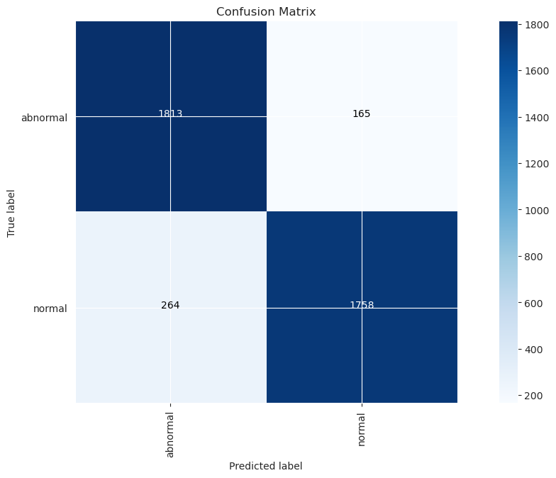
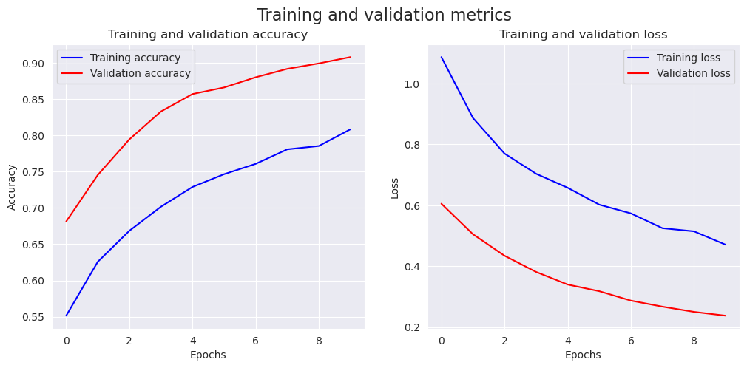
EfficientNetB7 Model - 2 Class Classification

Slide 17
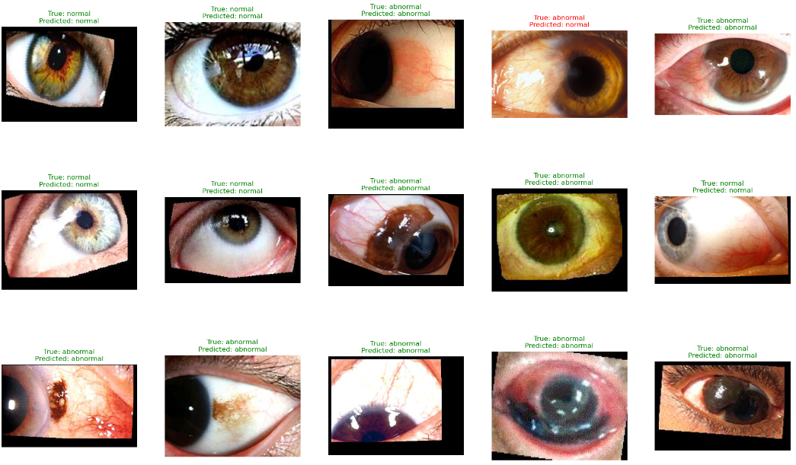
EfficientNetB7 Model - 2 Class Classification

Slide 18
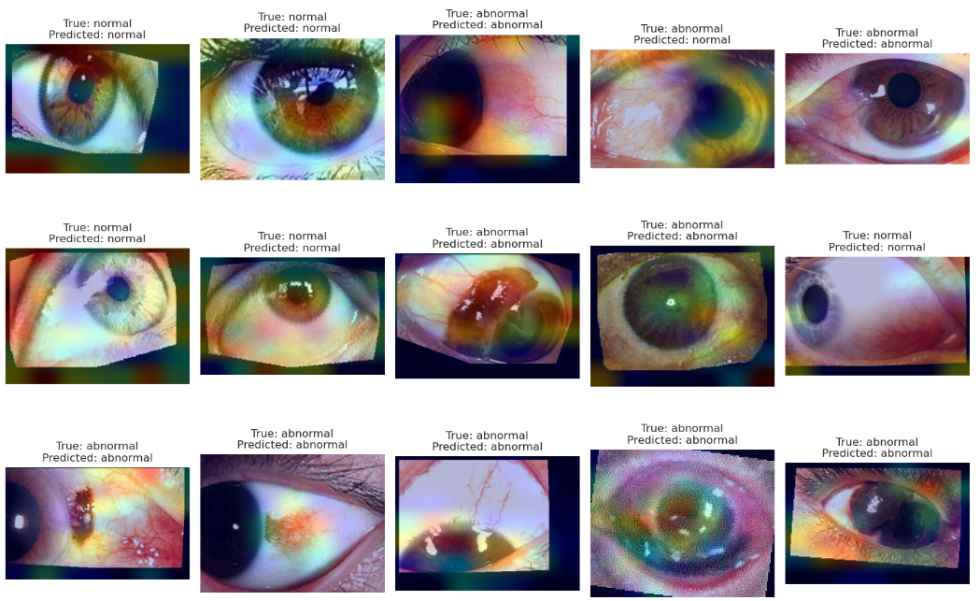
EfficientNetB7 Model - 2 Class Classification
Using Grad-CAM:
To visualize the regions of an input image that were most relevant for the neural network prediction which allows to see which regions of the image the model focused on while making its prediction.

Slide 19
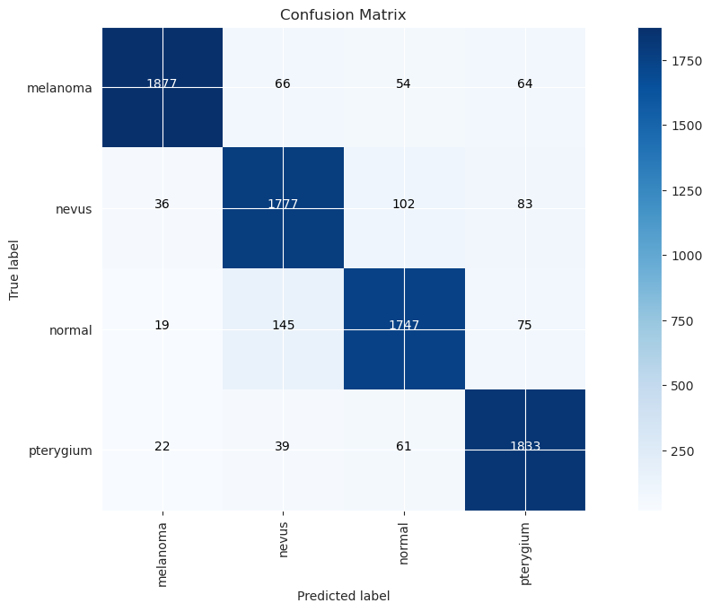
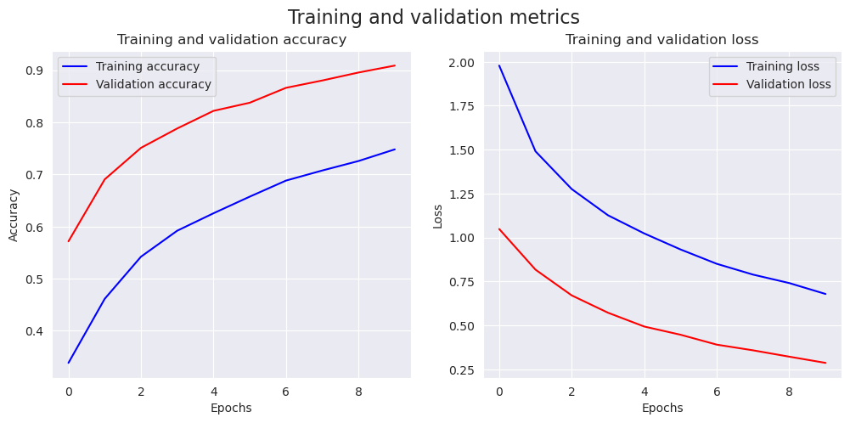
EfficientNetB7 Model - 4 class Classification
4-class Image classification of “normal”, “nevus”, “melanoma” and “pterygium” using Tensorflow considering 10,000 images in each class
The model was trained for 10 epochs.
Results obtained after training for 10 epochs:
Train Loss: 0.6785
Train Accuracy: 0.7482
Validation Loss: 0.2863
Validation Accuracy: 0.9089
Test Loss: 0.29456
Test Accuracy: 90.43%

Slide 20
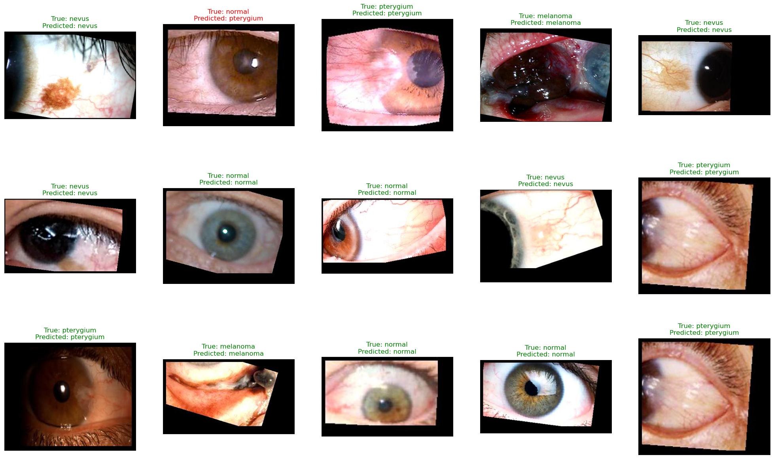
EfficientNetB7 Model - 4 Class Classification

Slide 21
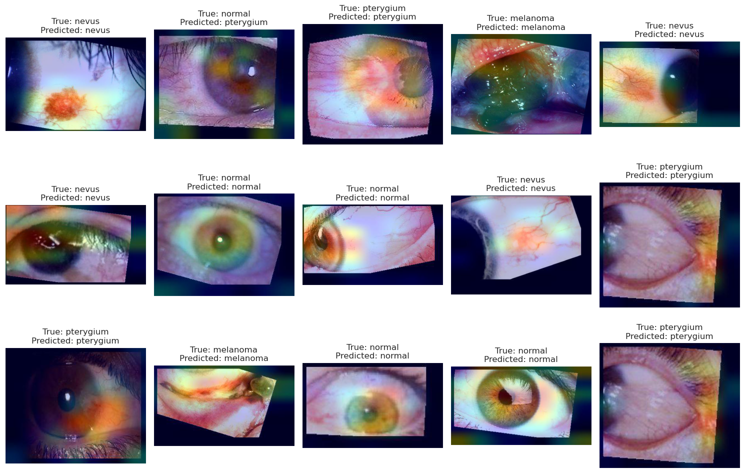
EfficientNetB7 Model - 4 Class Classification
Using Grad-CAM:

Slide 22
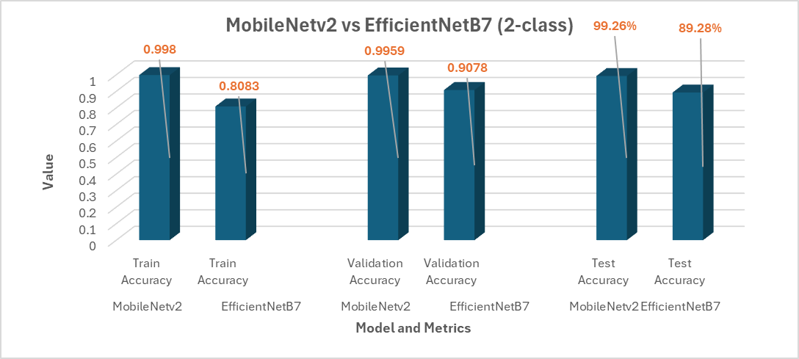
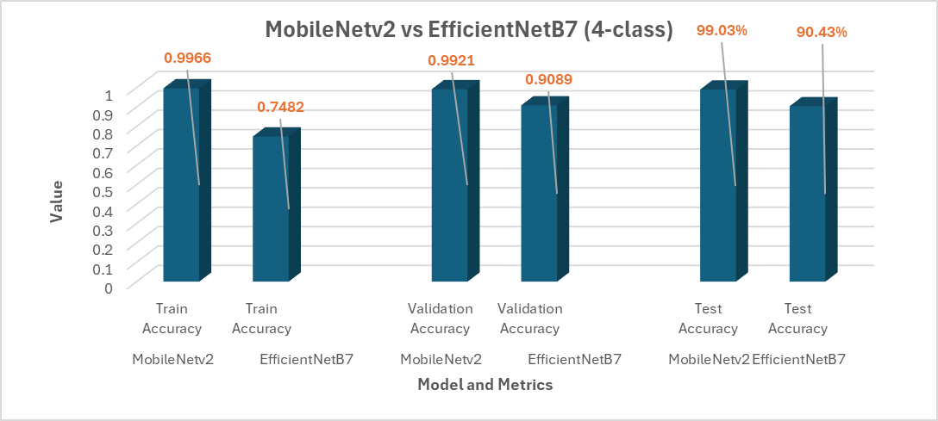
Conclusion
It was observed that for both binary and 4-class classification where the dataset had 10,000 images for each of the classes, MobileNetv2 Model gave better accuracy and evaluation metric values in comparison to the EfficientNetB7 Model.

Slide 23
References
References of Research Papers:
Adopting low-shot deep learning for the detection of conjunctival melanoma using ocular surface images: (Tae Keun Yoo, et al. - 2023)
Deep Learning-Based Conjunctival Melanoma Detection Using Ocular Surface Images: (Kanchon Kanti Podder et al. - 2021)
Dataset source: http://dx.doi.org/10.17632/t75wjsw6bw (images were verified by ophthalmologists)
THANK YOU!

